Slide 1



TIM CLUB 2
MEDICAL HEALTHCARE
Your health, our priority. Compassionate care, innovative solutions—because your well-being is the heart of our mission.
THE
INTELLIGENT MINDS
CLUB

Slide 2

Table of content
About Us
Problematic
Our Solution
Our Work

Slide 3
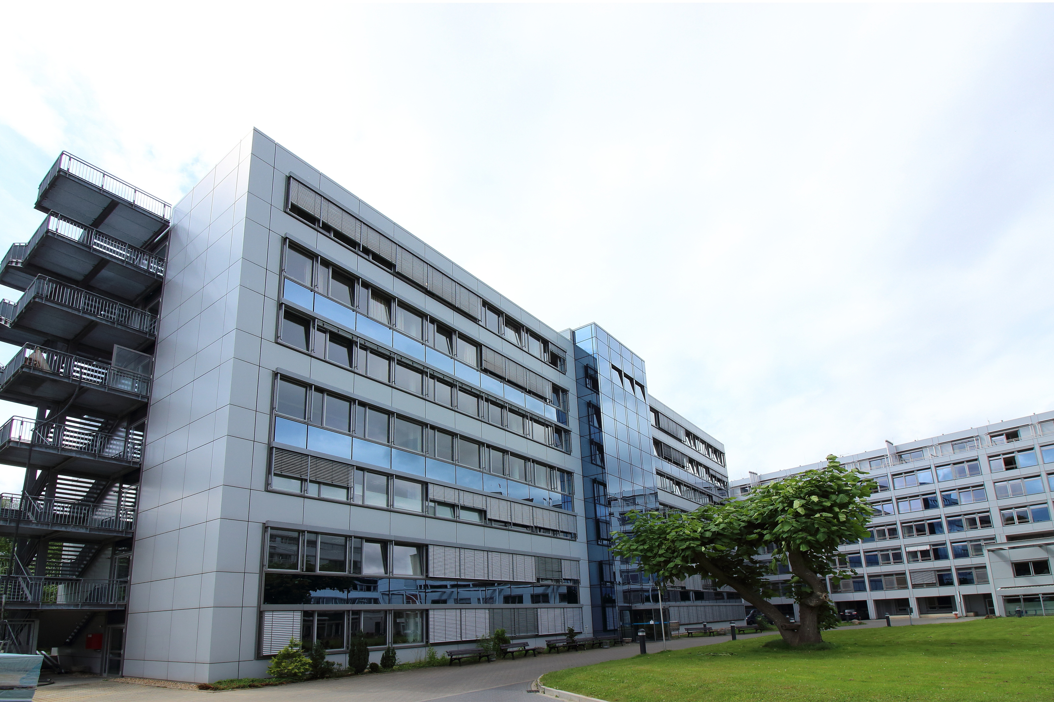
About Us
Belakhdar Abderrahmane - M2 ISI computer science
Azzaz youssef - L3 computer Science
Haoud Azzedine - L3 computer Science
`` Mustapha Stamboli Mascara University ``

Slide 4
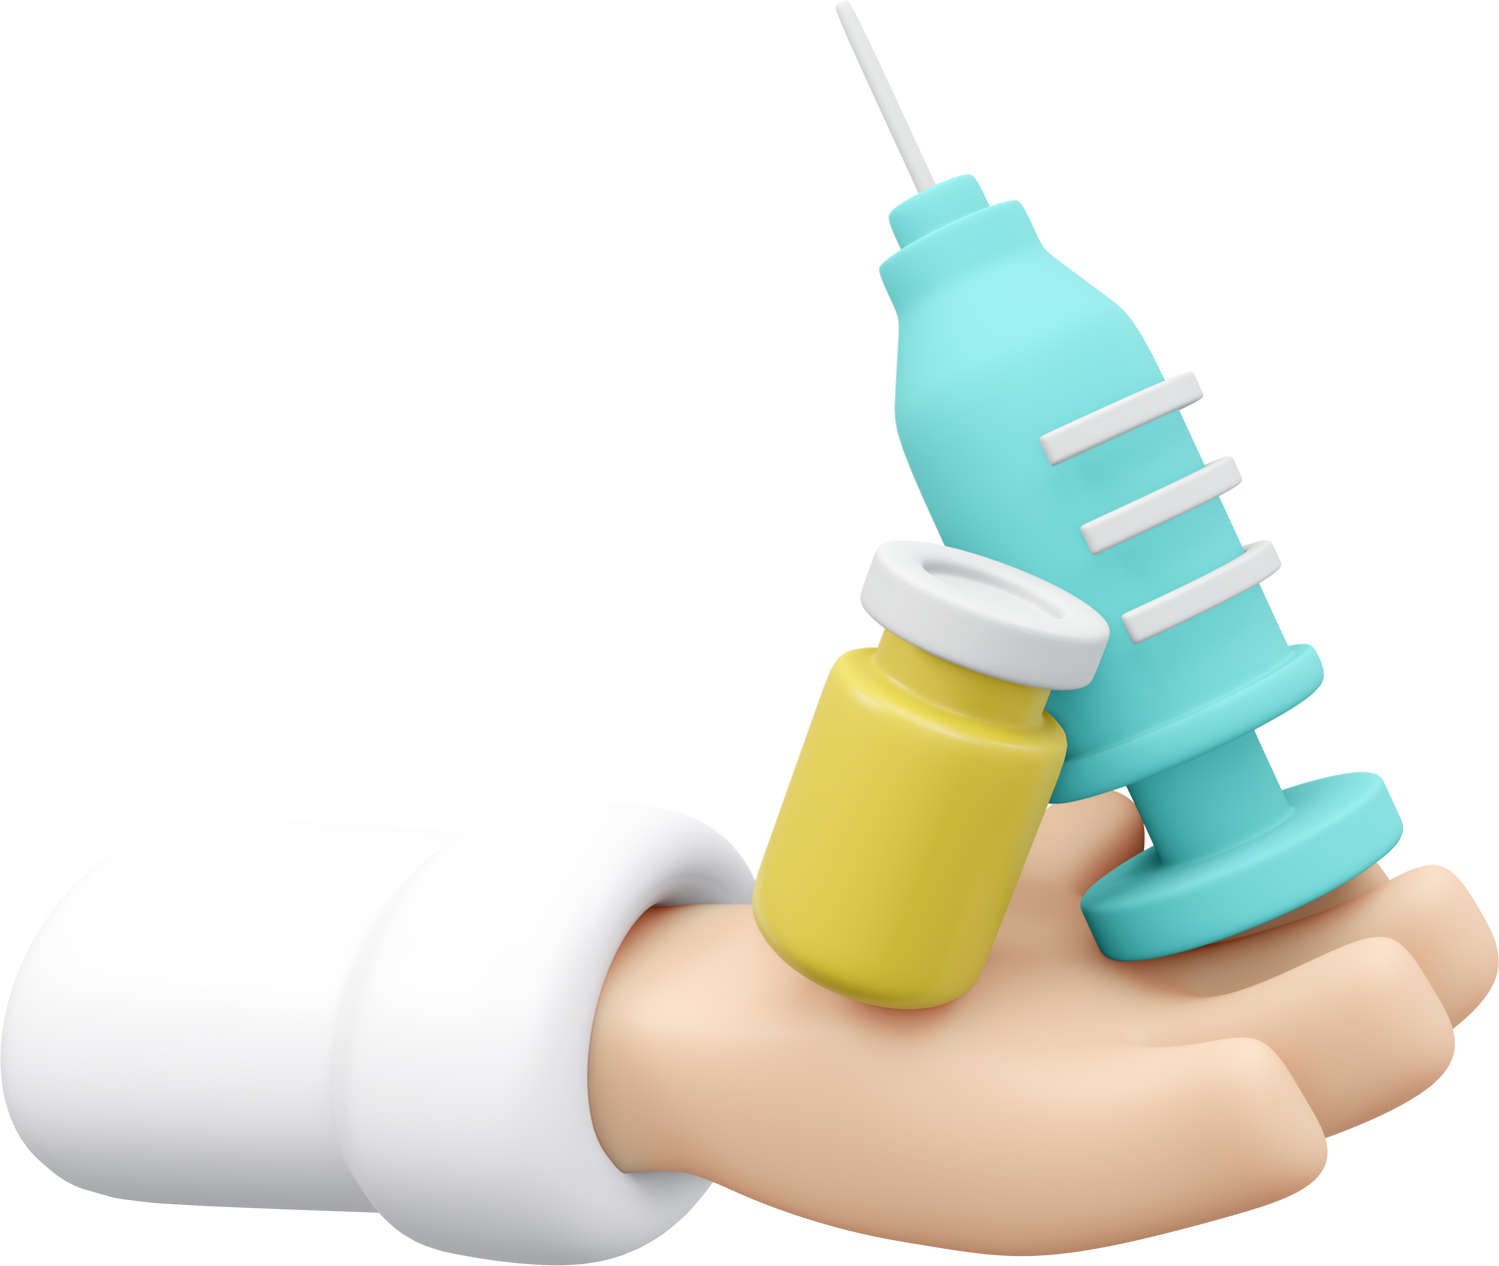
Problematic
Polypharmacy makes medication shortages worse by increasing demand for certain drugs. This creates problems in getting enough medication, which is tough for patients who need many drugs to stay healthy.

Slide 5
Our Solution
Medication Optimization
Collaboration and Communication
Minimize Pollution
Healthcare professionals can review patients' medication regimens regularly to identify and eliminate unnecessary or redundant medications, reducing overall demand for medications and minimizing the risk of shortages.
Healthcare providers, pharmacists, and patients can collaborate to communicate medication shortages promptly and work together to find suitable alternatives or solutions to minimize disruptions in patient care.
Burning medications can release pollutants such as particulates mater . improper use of medications can result in the release of their chemicals in the environment
01
02
03

Slide 6
Our Solution
Early Disease Detection
Healthcare Cost Reduction
Specialist Recommendation
Implementing disease prediction models can facilitate early detection of diseases, allowing for timely intervention and treatment. Early detection can lead to better health outcomes, reduced disease progression, and improved quality of life for patients.
Early disease detection and preventive interventions facilitated by predictive models can lead to cost savings for healthcare systems by reducing the need for expensive treatments, hospitalizations, and emergency care. By focusing on prevention and proactive management, healthcare costs can be mitigated, benefiting both individuals and society as a whole.
Directing individuals to specialists for further evaluation and treatment based on predictive disease models can streamline the healthcare process and ensure timely access to appropriate care.
04
05
06

Slide 7
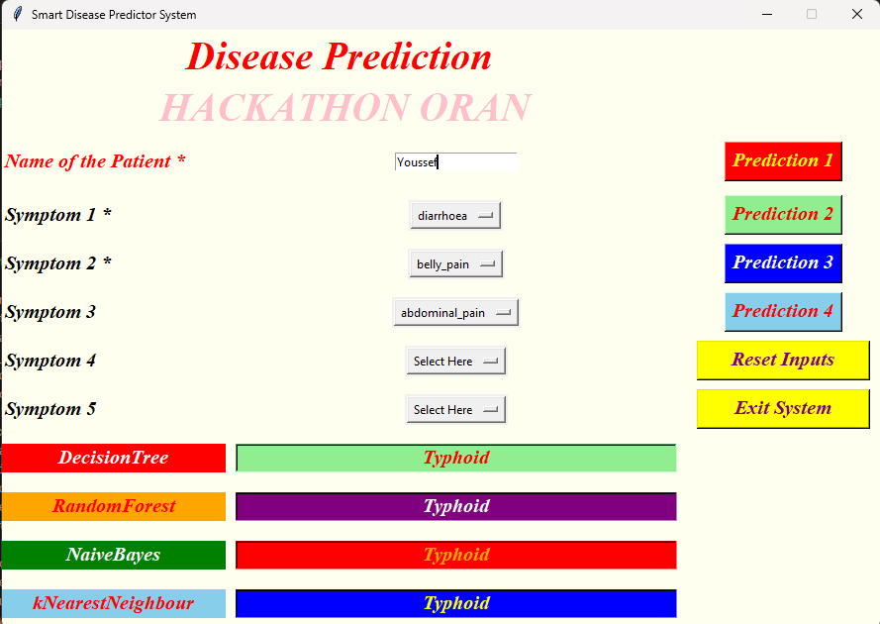
Our Work

Slide 8
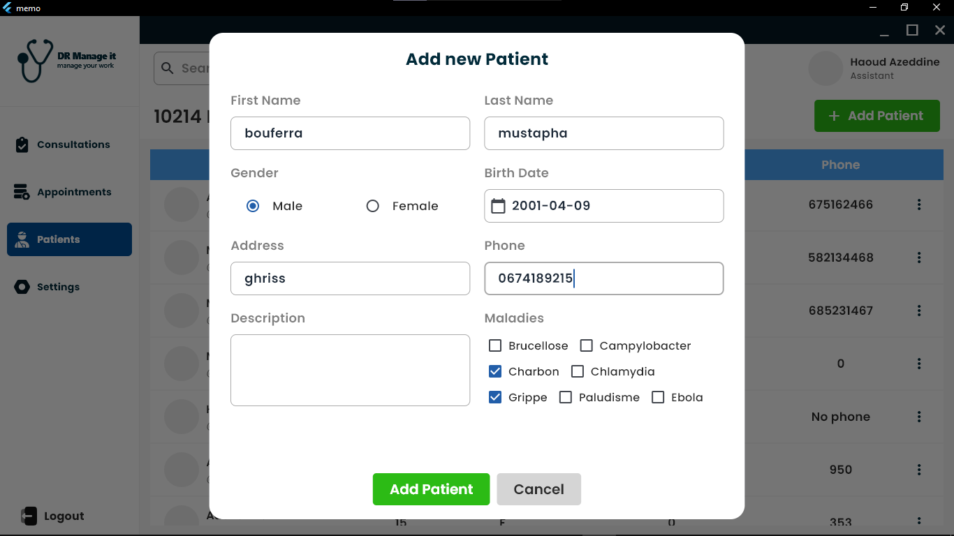

Slide 9
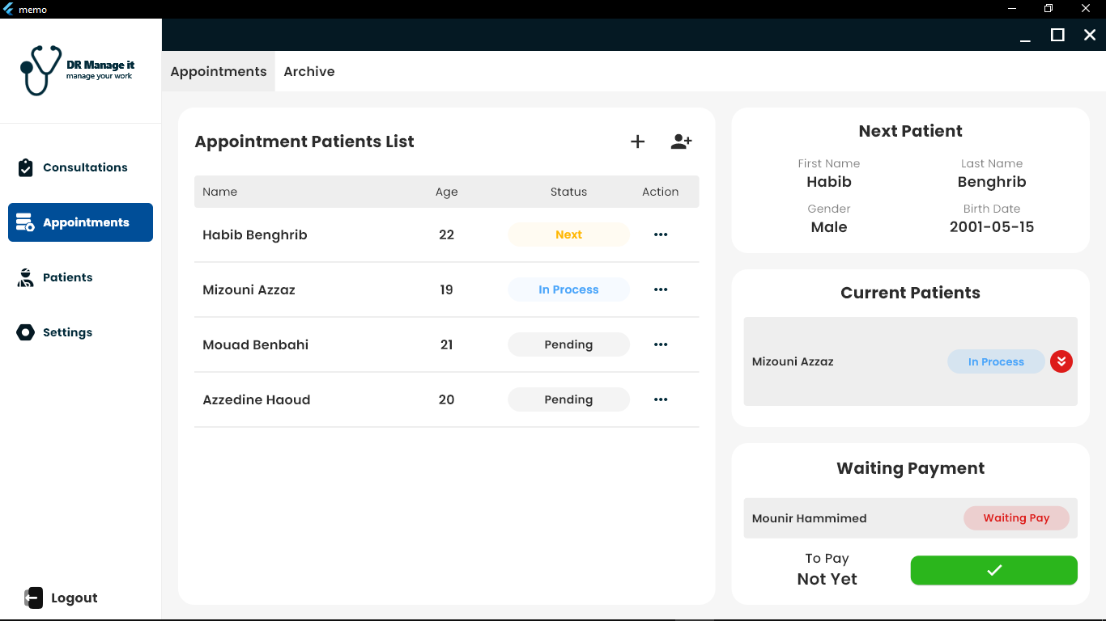

Slide 10
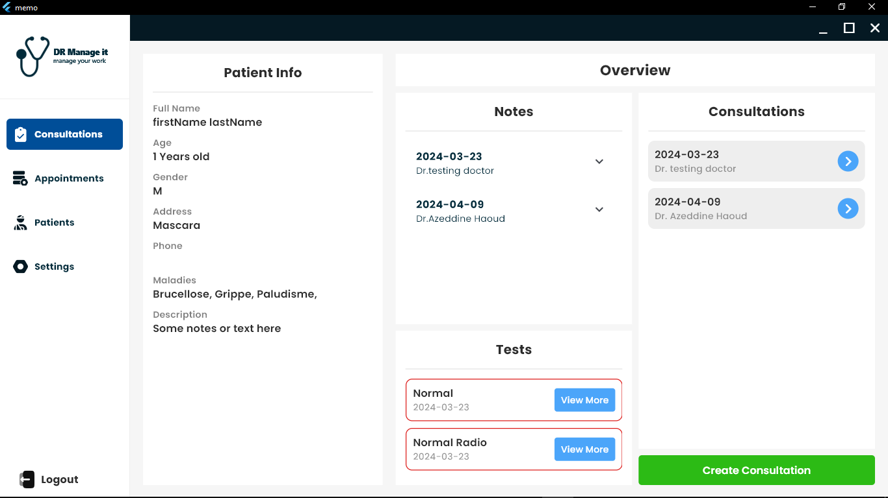

Slide 11
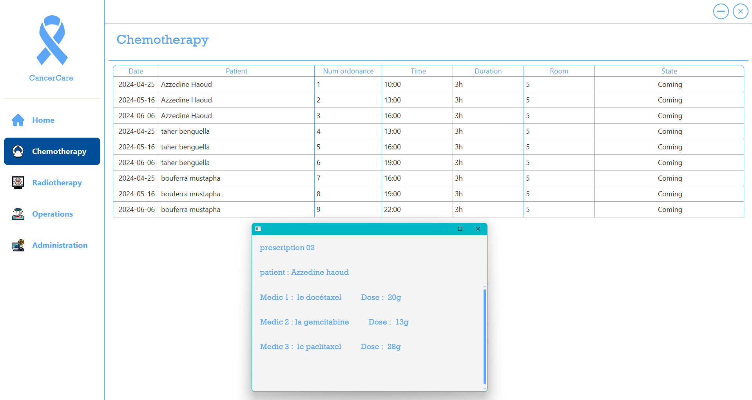

Slide 12
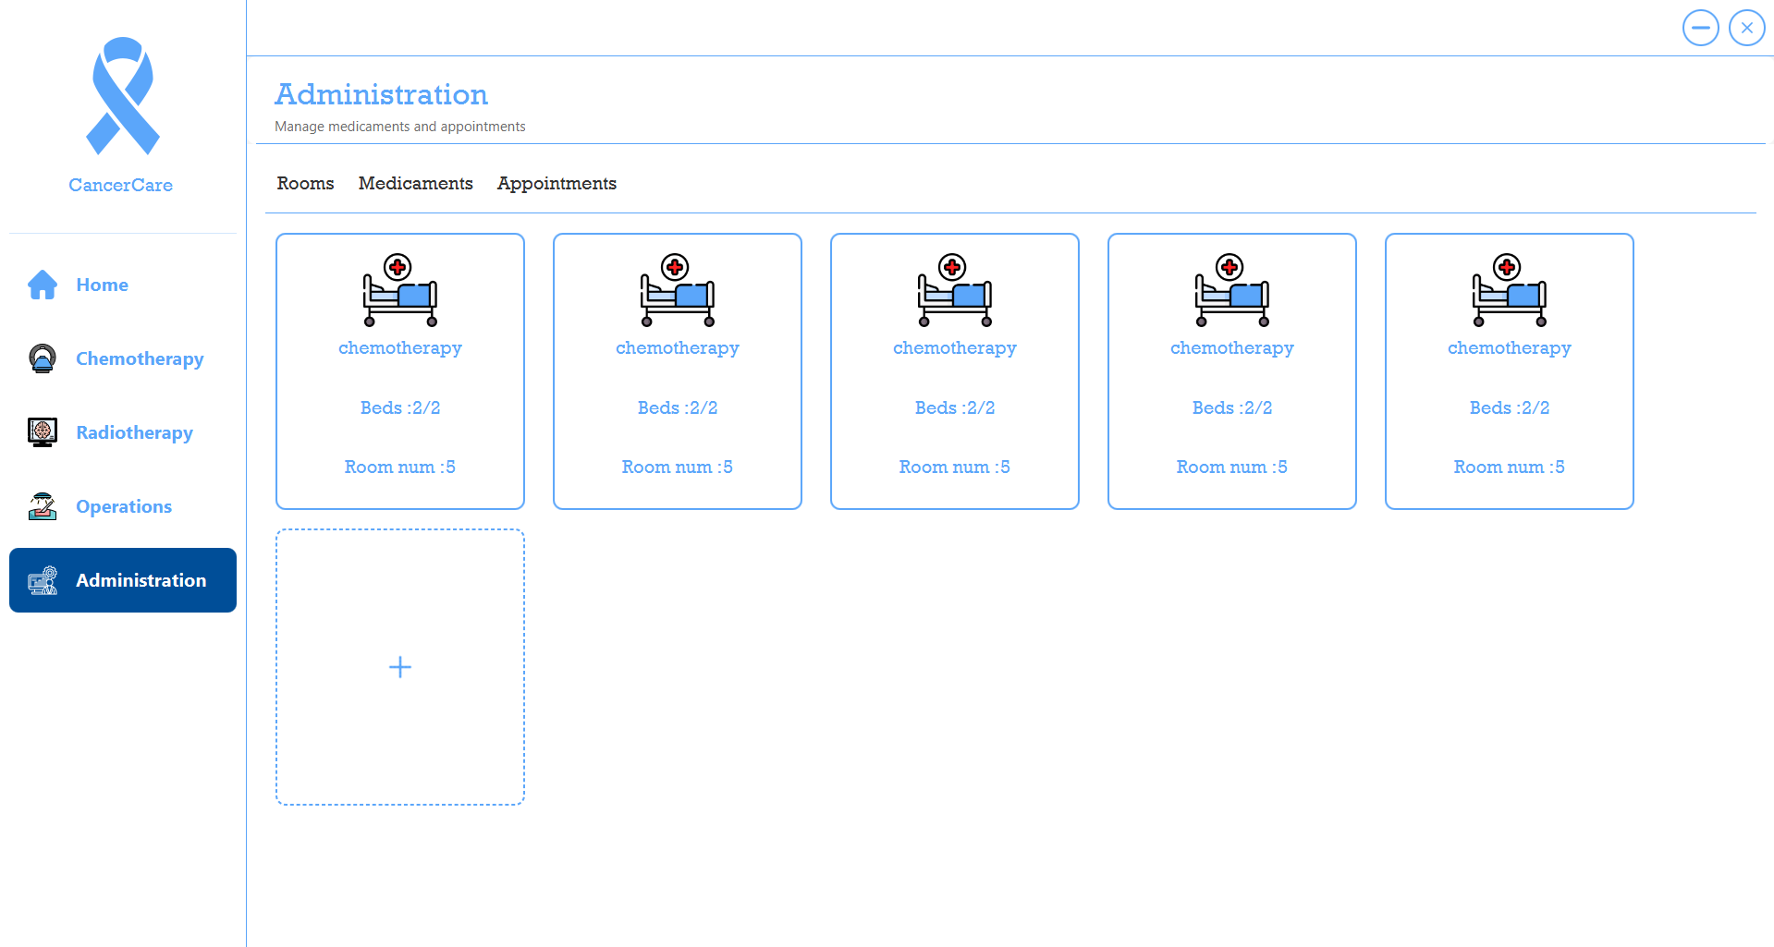

Slide 13
Thank
You

